Slide 1
Predictive Analytics
Bank’s Term Deposit Subscription
Name: Mang Bao Tran

Slide 2
Table of contents
01
03
02
04
Dataset
Pre-processing
EDA
Model

Slide 3
01
Dataset Introduction

Slide 4
Intro
The data is related to direct marketing campaigns (phone calls) of a Portuguese banking institution.
The classification goal is to predict if the client will subscribe to a term deposit
Source: Kaggle

Slide 5
This dataset has 45211 records with 17 columns

Slide 6
Detailed Column Descriptions
Column | Description | Column | Description
age | age of clients | day | last contact day of the month
job | type of job | month | last contact month of year
marital | marital status | duration | last contact duration (seconds)
education | type of education | campaign | number of contacts performed during this campaign and for this client
default | has credit in default? (yes/no) | pdays | number of days that passed by after the client was last contacted from a previous campaign
balance | average yearly balance (euros) | previous | number of contacts performed before this campaign and for this client
housing | has housing loan? (yes/no) | poutcome | outcome of the previous marketing campaign
loan | has personal loan? (yes/no) | y (subscribed) | has the client subscribed a term deposit? (yes/no)
contact | contact communication type

Slide 7
Variables
Quantitative
Classification
Binary (yes/no)
age
balance
duration
campaign
pdays
previous
job
education
contact
marital
poutcome
month
day
default
housing
loan
subscribed (target)
Predict if the client will subscribe to a term deposit

Slide 8
02
Explore Data Analysis

Slide 9
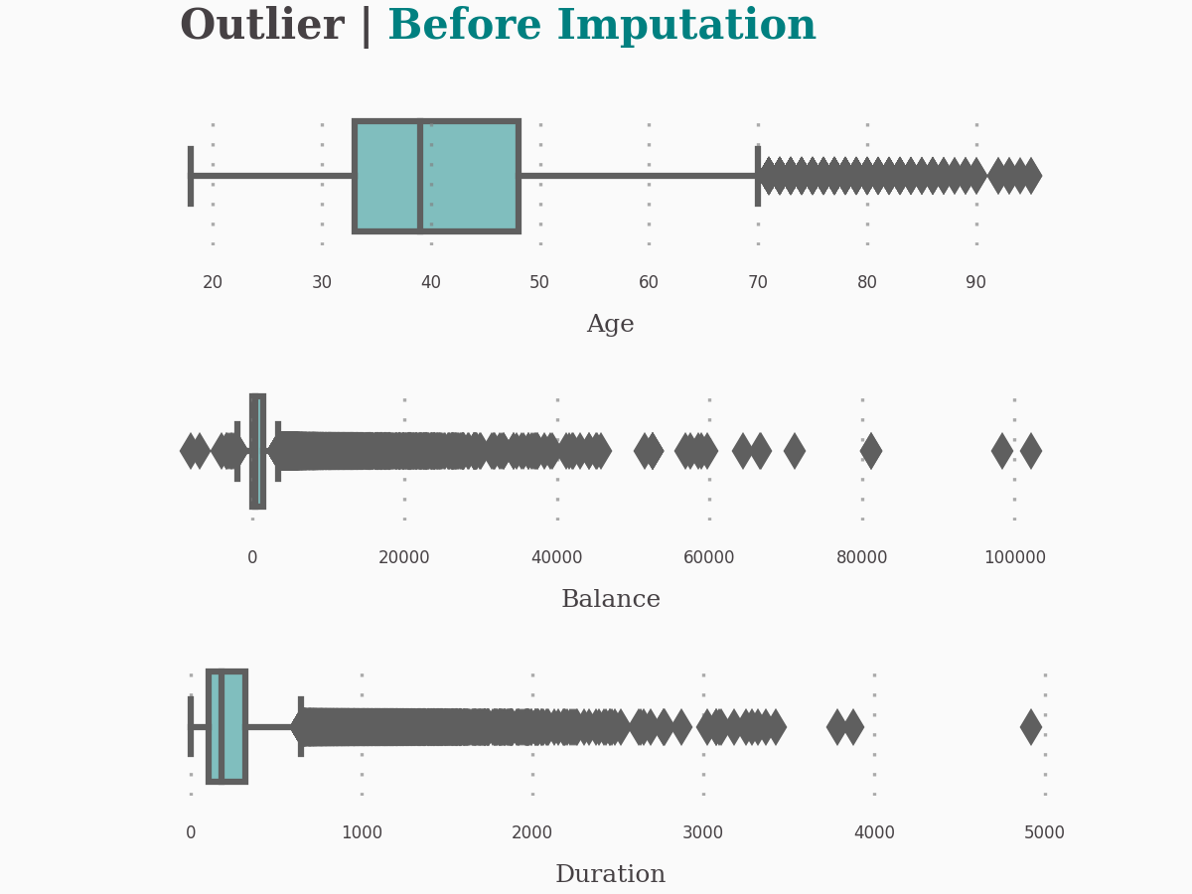
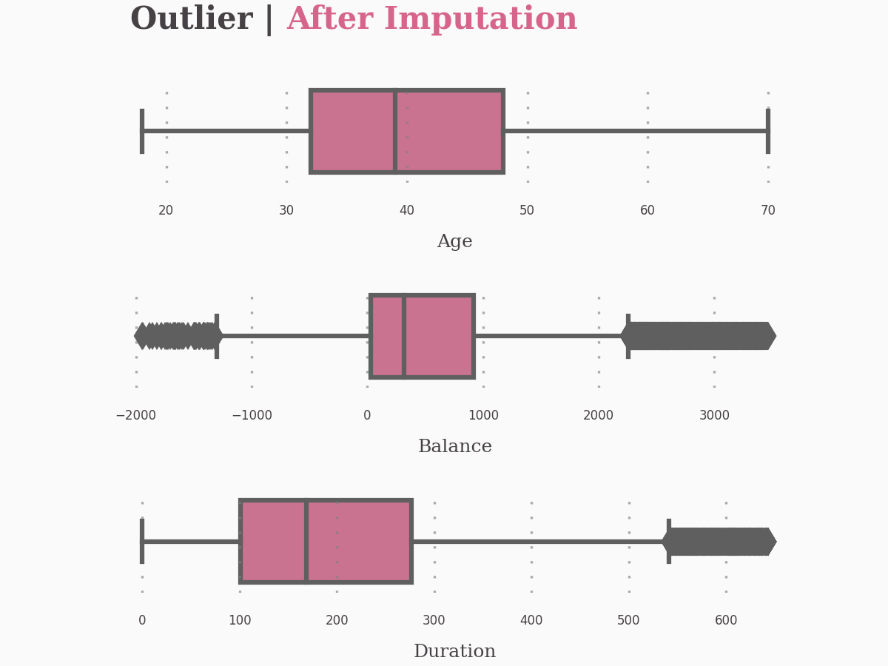
Handling Outliers
Data length before imputation is: 45211
Data length after imputation is: 28193

Slide 10
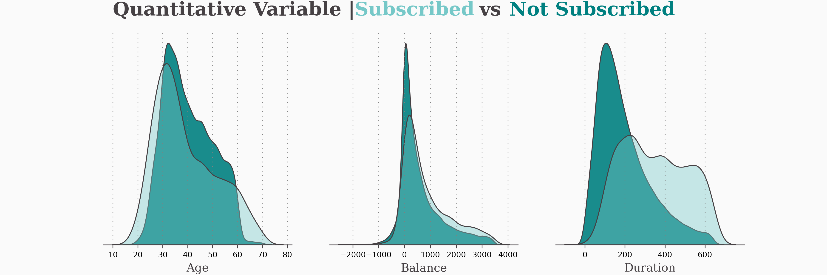
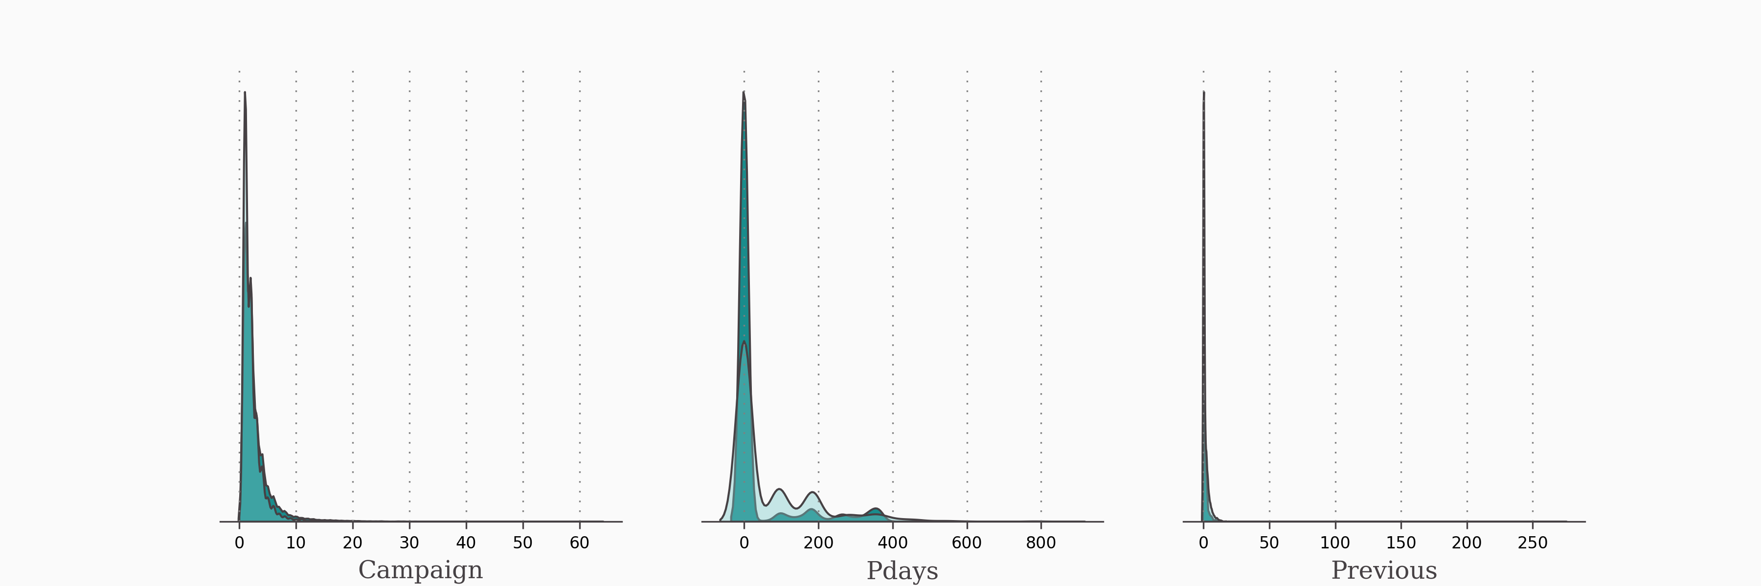
Quantitative Variables
Age and Balance have the same distribution between subscribed and not subscribed.
Duration look to be a prominent factor.
They can be quite good features in our models.
Campaign, Pdays and Previous have many outliers. They are too hard to be features to predict.

Slide 11
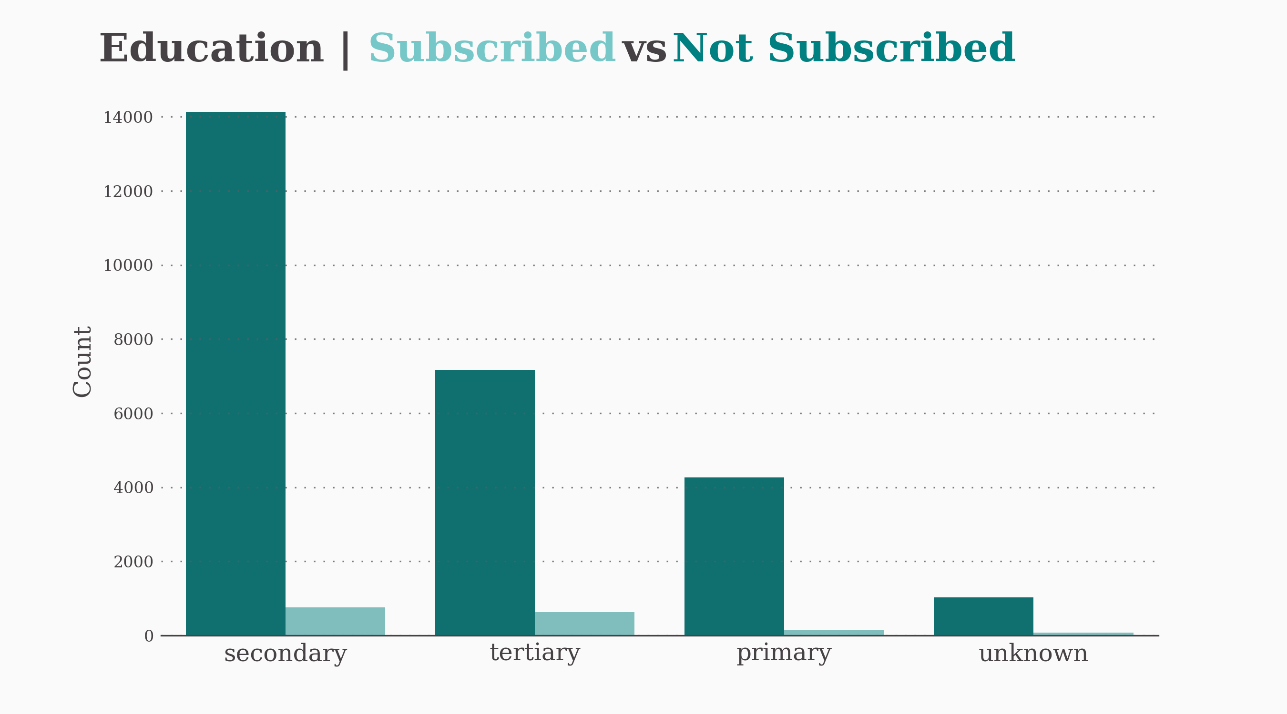
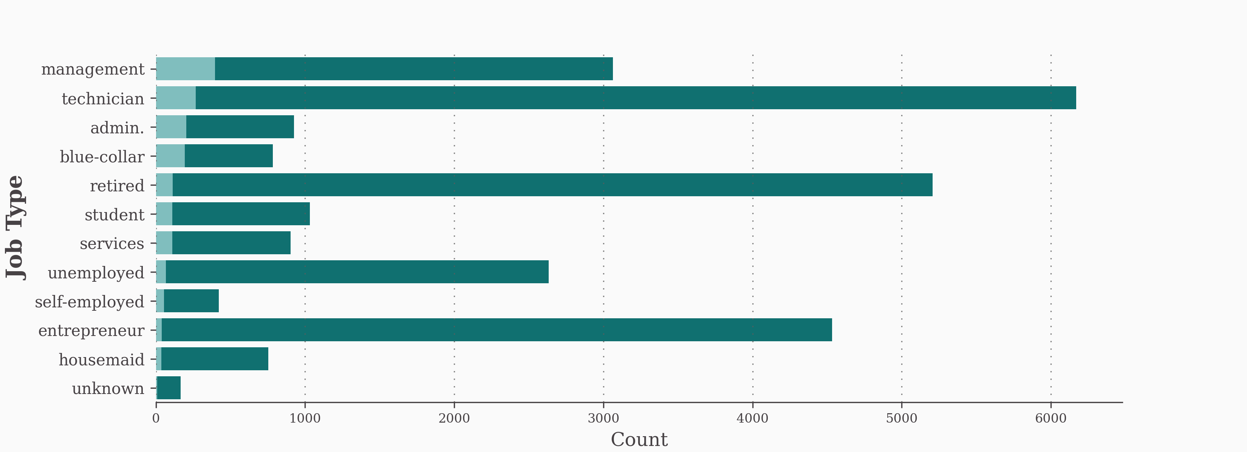
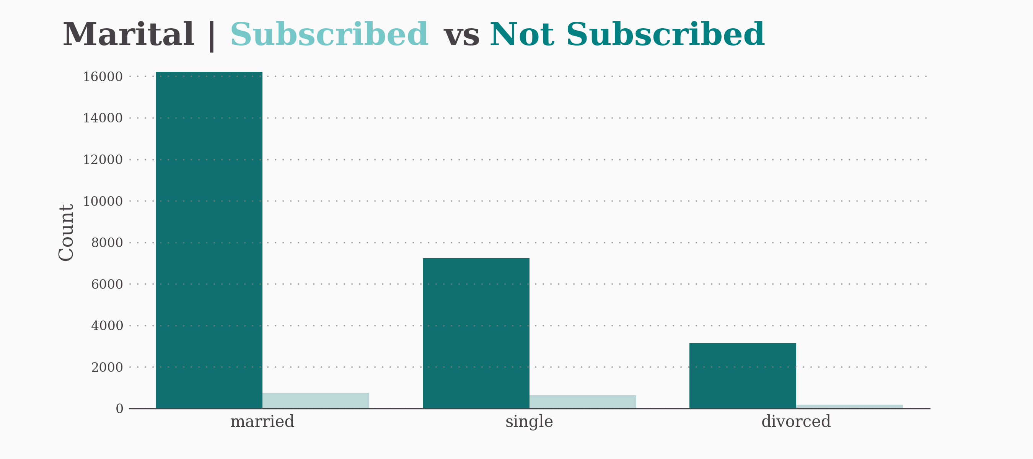
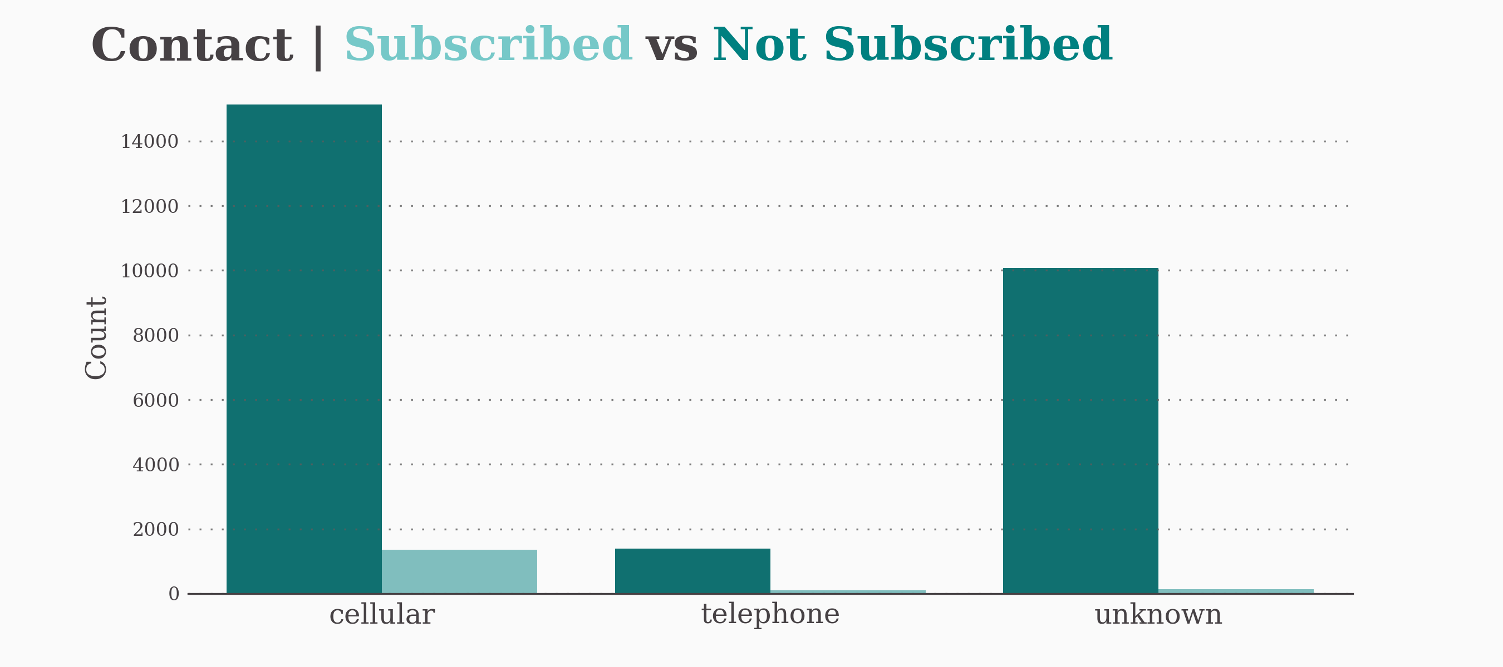
Classification Variables
They are good features for predicting who subsribes this campaign.

Slide 12
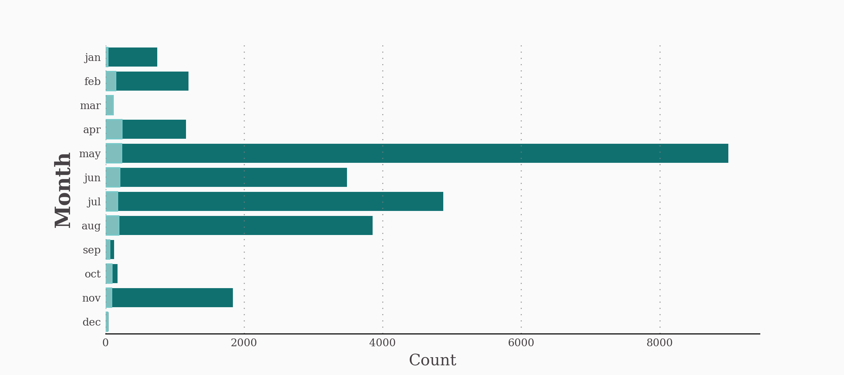
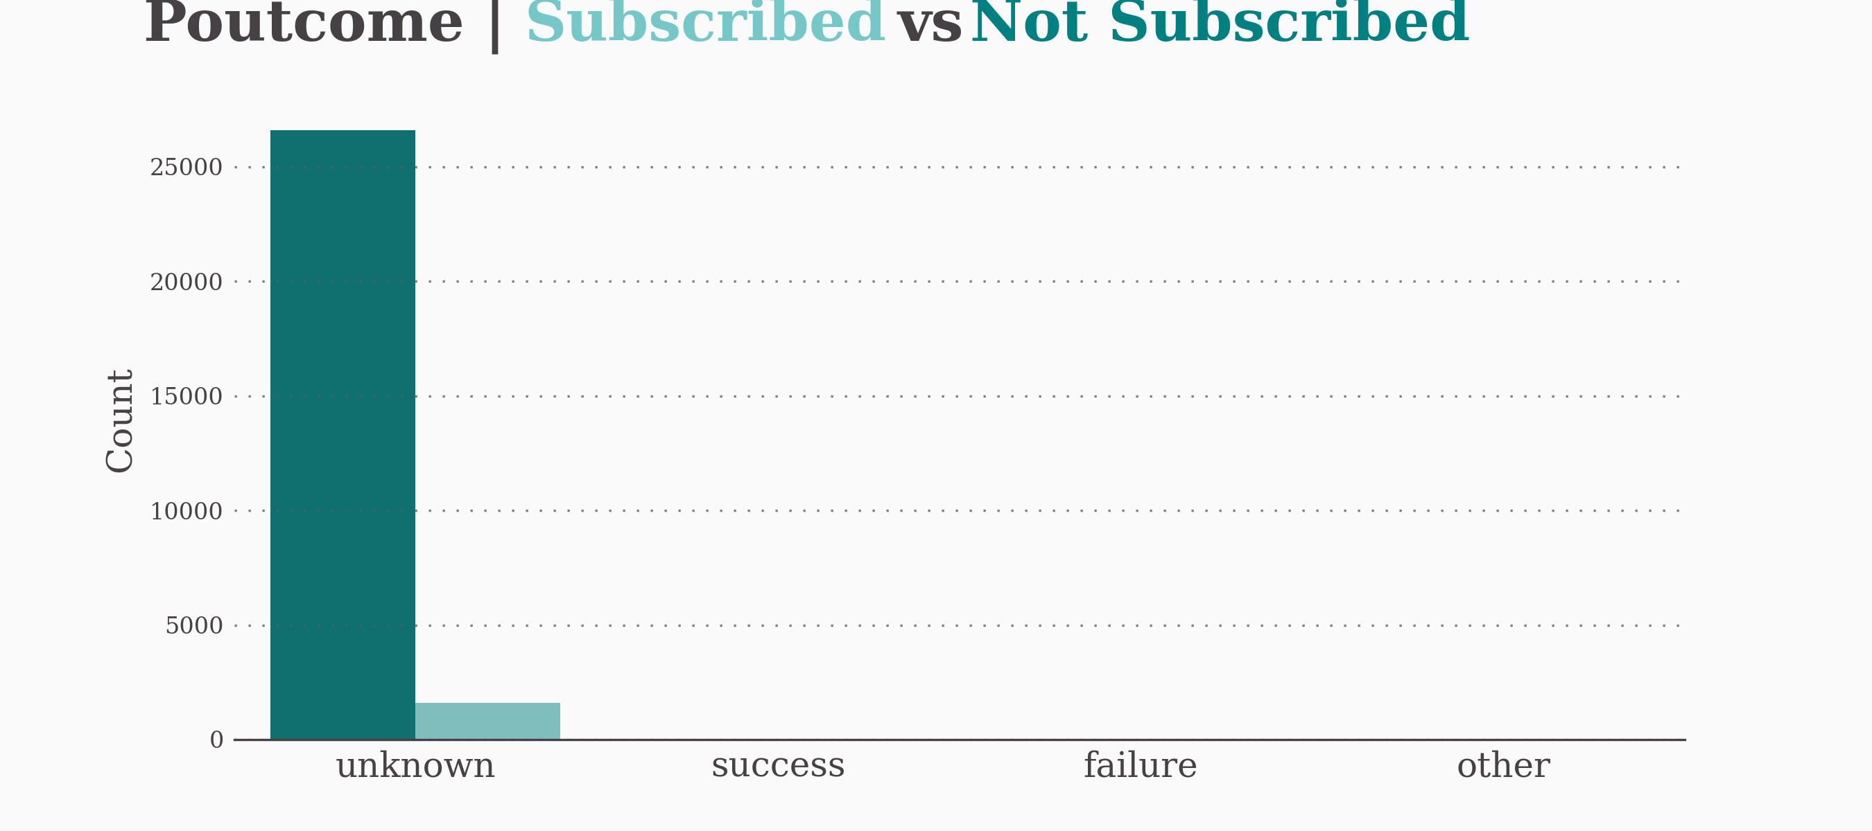
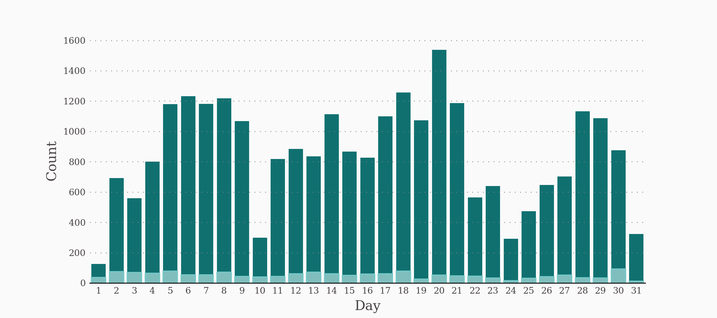
Classification Variables
They are not good features for predicting who subsribes this campaign.

Slide 13
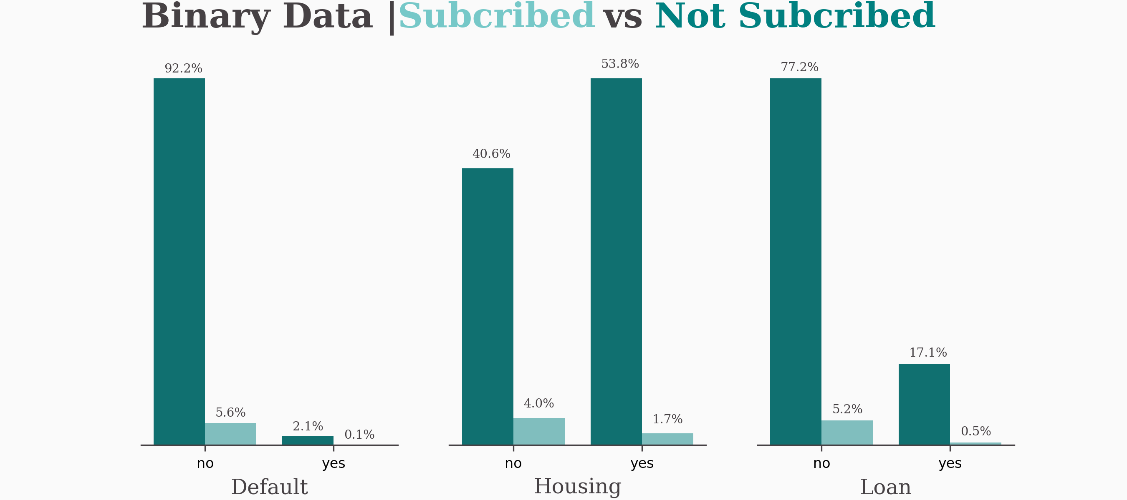
Binary Variables
People with credit wouldn't want to subscribe to a new bank.
People without housing loans are in a higher proportion who decide to subscribe to deposits
Clients who do not have personal loans tend to be willing to accept deposit offers.

Slide 14
03
Pre-processing data

Slide 15
Determine Features and Target
Variables
Quantitative
Classification
Binary (yes/no)
age
balance
duration
campaign
pdays
previous
job
education
contact
marital
poutcome
month
day
default
housing
loan
subscribed (target)
‘subscribed’ column is the target, the rest are features

Slide 16
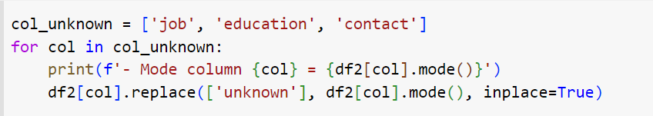
Replace ‘Unknown’ values
Column | Mode value
Job | blue-collar
Education | secondary
Contact | cellular

Slide 17
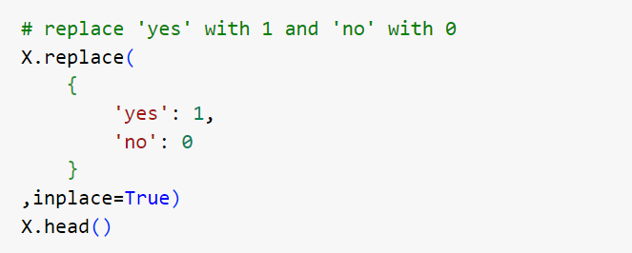
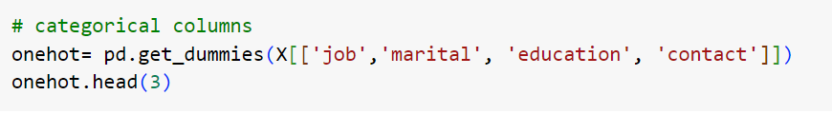
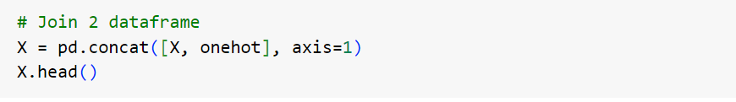
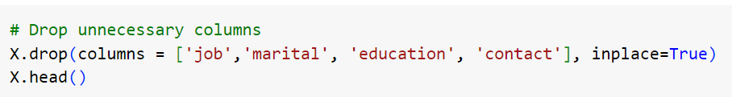
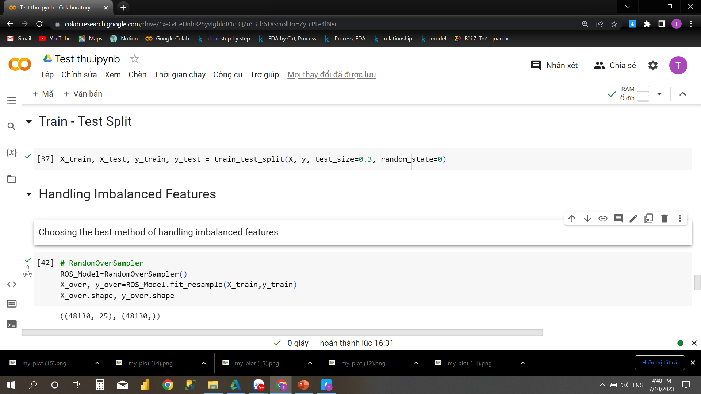
Encoding
Train/Test Split
70% Train – 30% Test

Slide 18
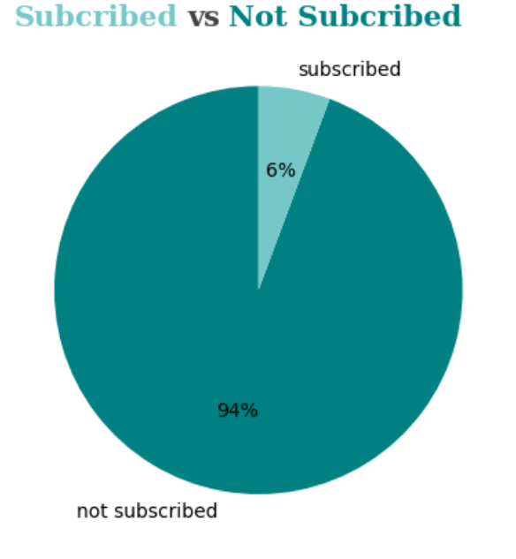
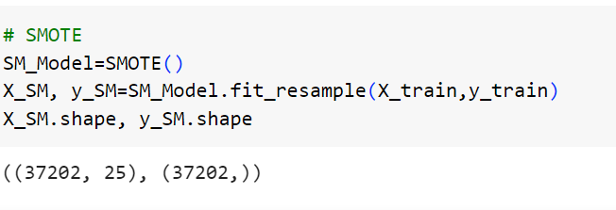
Handling Imbalanced Features

Slide 19
04
Model

Slide 20
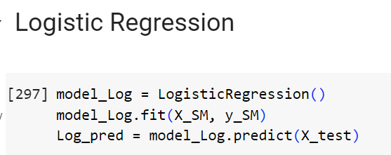
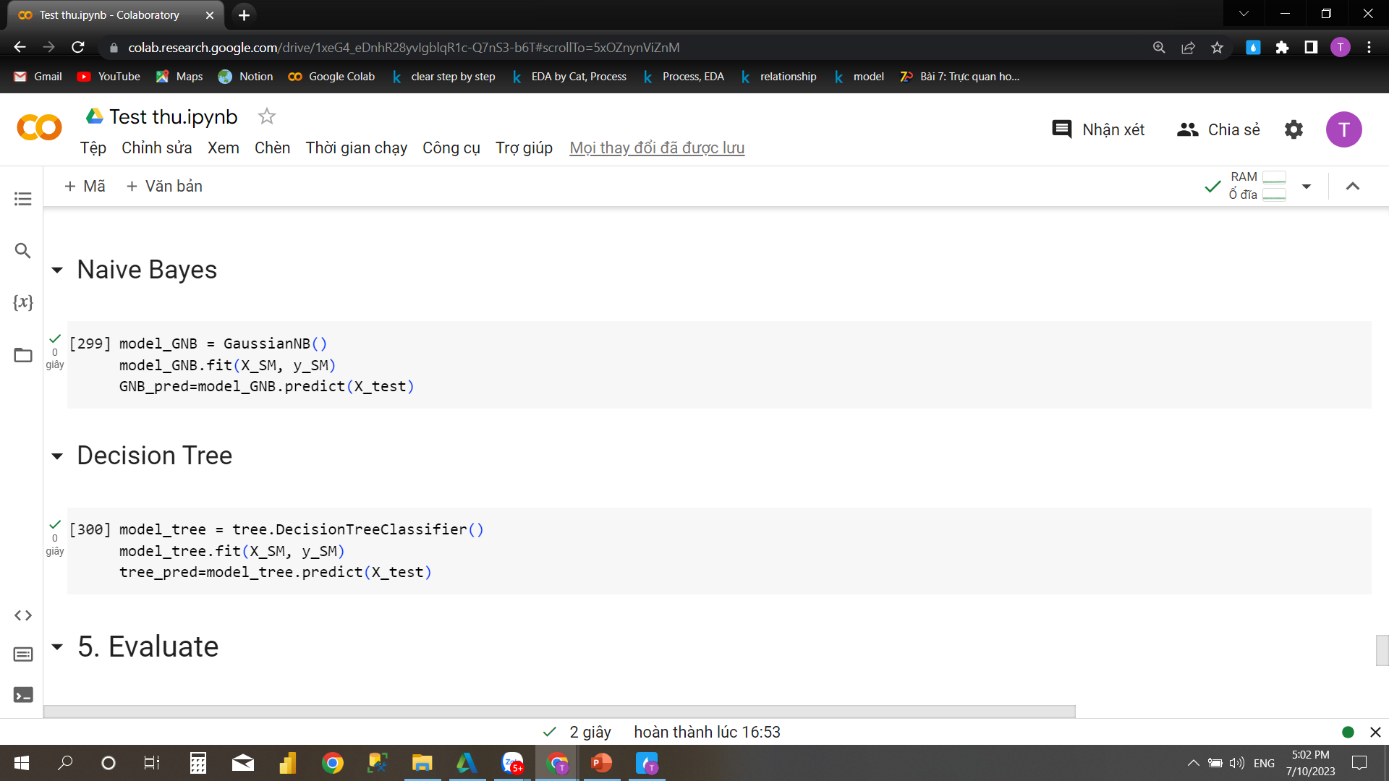
Training Model

Slide 21
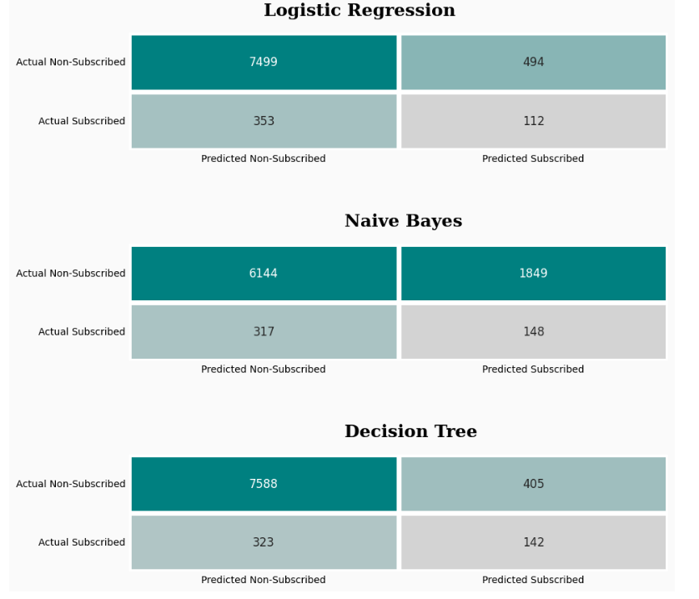
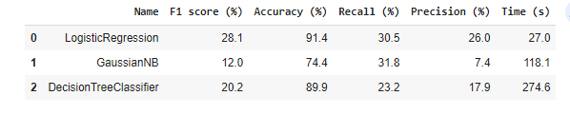
Model Comparision
Logistic Regression has the best F1 score, Accuracy and Precison score. It takes only 27s to process.
Naive Bayes has the lowest metric evaluation value among the three types of classification
Decision Tree is a good model. But the Logistic Regression is better.
So, Logistic regression is the model chosen for the production process.

Slide 22
Thank you!

